Slide 1





A2-Level Maths:
Core 4 for Edexcel
C4.6 Integration 2
These icons indicate that teacher’s notes or useful web addresses are available in the Notes Page.
This icon indicates the slide contains activities created in Flash. These activities are not editable.
For more detailed instructions, see the Getting Started presentation.
<number> of 66
© Boardworks Ltd 2006

Slide 2



Using trigonometric identities in integration
Using trigonometric identities in integration
Using partial fractions in integration
First-order differential equations
Differential equations with separable variables
Using differential equations to model real-life situations
The trapezium rule
Examination-style questions
Contents
<number> of 66
© Boardworks Ltd 2006

Slide 3
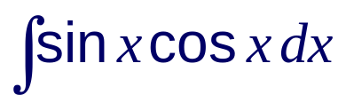

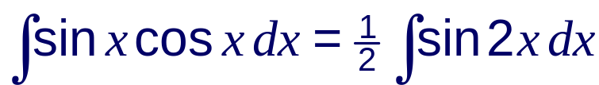

Using trigonometric identities in integration
Many expressions involving trigonometric functions cannot be integrated directly using standard integrals.
In these cases, it may be possible to rewrite the expression using an appropriate trigonometric identity.
For example:
Find .
Using the double angle formula for sin 2x:
So, we can write:

Slide 4




Integrating cos² x and sin² x
To integrate functions involving even powers of cos x and sin x we can use the double angle formulae for cos 2x.
There are two ways of writing this involving sin² x and cos² x:
We can rewrite these with sin² x and cos² x as the subject:
1
2
Notes:
Explain that these two identities allow us to write powers of sin x and cos x, which can’t be integrated directly, into expressions involving multiple angles which can be integrated directly using the chain rule.

Slide 5
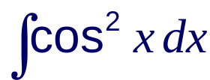
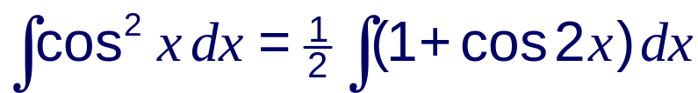

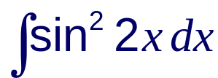
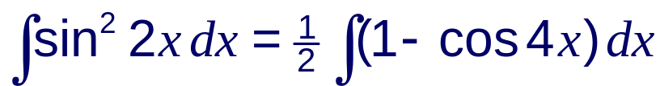

Integrating cos² x and sin² x
Find .
Using
1
Find .
Using and replacing x with 2x gives:
2

Slide 6
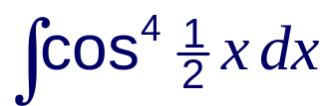

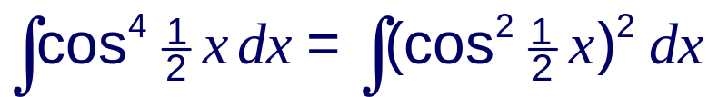
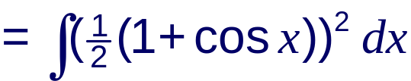
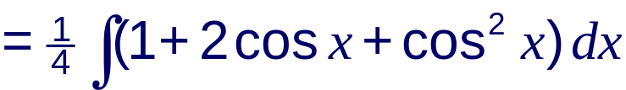
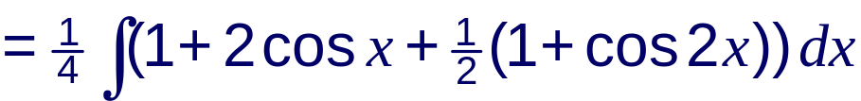
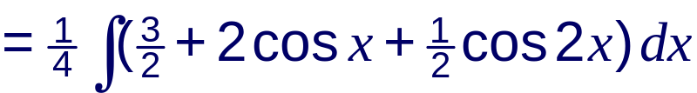

Integrating even powers of cos x and sin x
We can extend the use of these identities to integrate any even power of cos x or sin x. For example:
Find .
This can be written in terms of cos² x as:

Slide 7
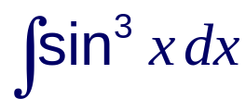
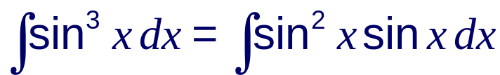
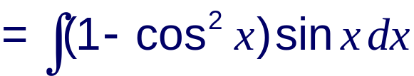
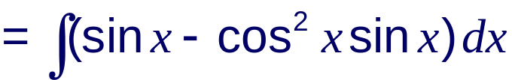
Integrating odd powers of cos x and sin x
Odd powers of cos x and sin x can be integrated using the identity cos² x + sin² x = 1.
1
2
Find .
Using
2

Slide 8
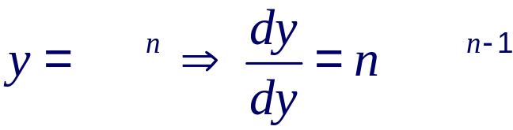
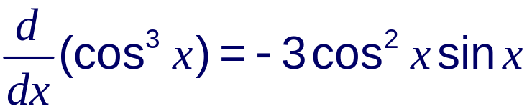
Integrating odd powers of cos x and sin x
This is now in a form that we can integrate.
The first part, sin x, integrates to give –cos x.
The second part, cos² x sin x, can be recognized as the product of two functions.
Remember the chain rule for differentiation:
where is f (x) and is f ’(x).
The derivative of cos x is –sin x and so:

Slide 9

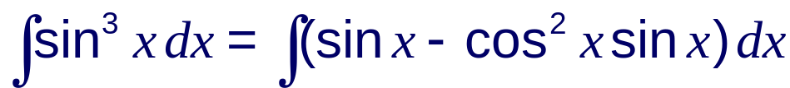


Integrating odd powers of cos x and sin x
Therefore,
So, returning to the original problem:

Slide 10
Using partial fractions in integration
Using trigonometric identities in integration
Using partial fractions in integration
First-order differential equations
Differential equations with separable variables
Using differential equations to model real-life situations
The trapezium rule
Examination-style questions
Contents
<number> of 66
© Boardworks Ltd 2006

Slide 11
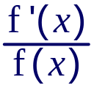
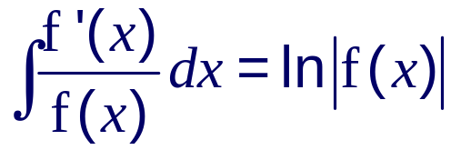
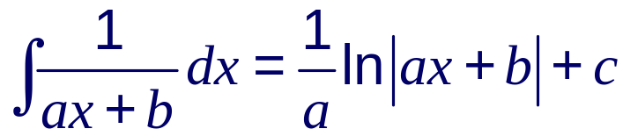
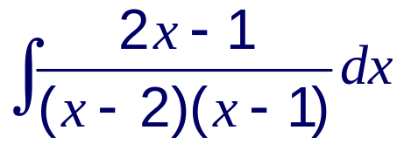
Integrating rational functions
We have seen that rational functions of the form can be integrated using:
In particular, if f(x) is a linear function then:
Suppose we want to integrate a rational function with more than one linear factor in the denominator.
For example:
Notes:
Stress that before splitting a rational function that we want to integrate into partial fractions, we should always check that the numerator is not the derivative of the denominator.
The denominator of the fraction in the example multiplies out to give x² – 3x + 2. The numerator 2x – 1 is not a the derivative (or a multiple of the derivative) of this. Therefore we must use partial fractions.

Slide 12
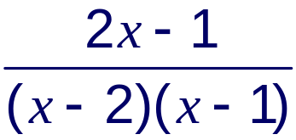
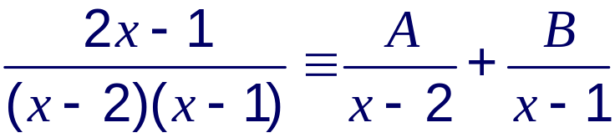





Using partial fractions in integration
We can integrate this by first splitting into partial fractions.
Let
Multiplying through by (x – 2)(x –1):
1
Substituting x = 2 into :
1
Substituting x = 1 into :
1

Slide 13
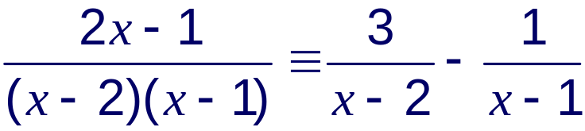
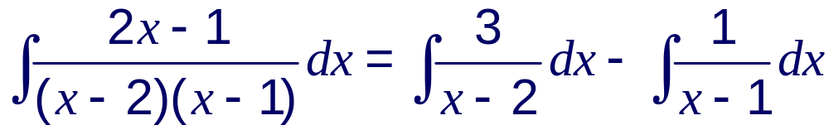

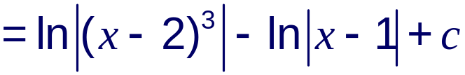
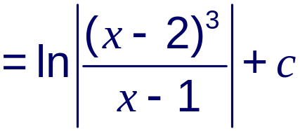
Using partial fractions in integration
So,
We can now integrate:

Slide 14
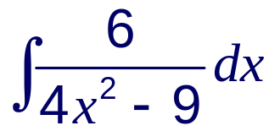
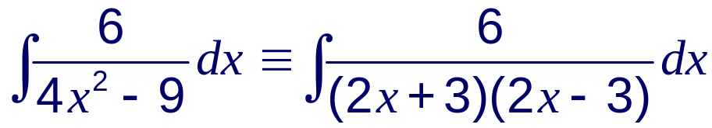
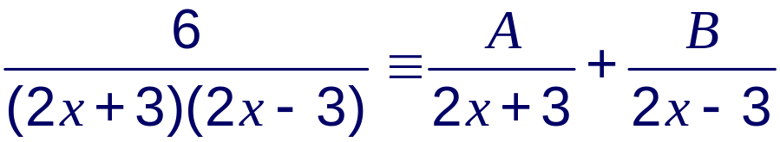

Using partial fractions in integration
Find .
The denominator involves the difference between two squares and so we can write:
Let
Multiplying through by (2x + 3)(2x – 3):
1

Slide 15








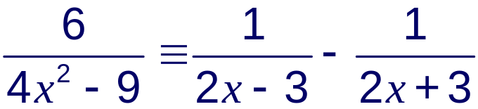
Using partial fractions in integration
Substituting x = into :
1
Substituting x = into :
1
So,

Slide 16
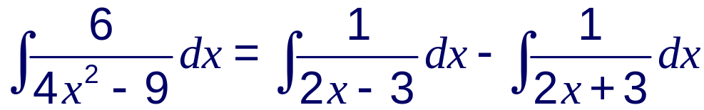

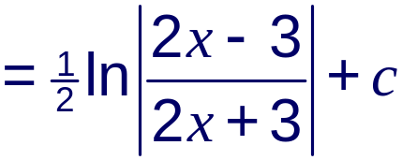
Using partial fractions in integration
We can now integrate:

Slide 17
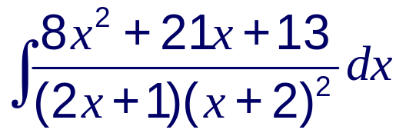
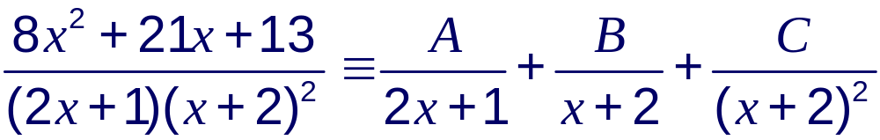




Using partial fractions in integration
Find .
Let
Multiplying through by (2x + 1)(x + 2)²:
1
Substituting x = into :
1

Slide 18






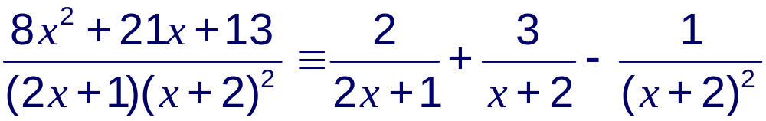
Using partial fractions in integration
Substituting x = –2 into :
1
Comparing the coefficients of x² :
So,

Slide 19
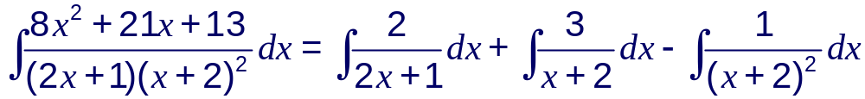
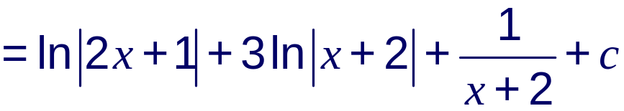
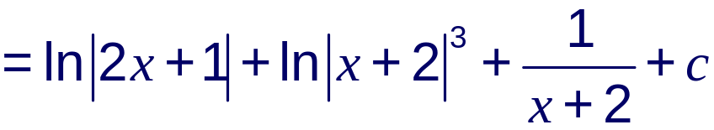
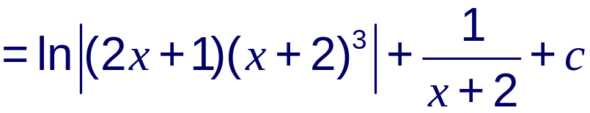
Using partial fractions in integration
We can now integrate:
The integral of (x + 2)⁻²
is –(x +2)⁻¹.

Slide 20
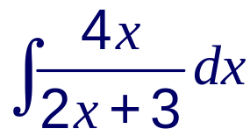
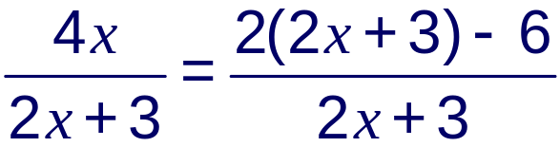
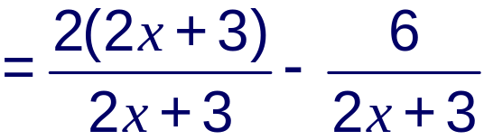
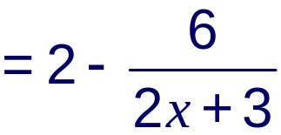
Using partial fractions in integration
To integrate an improper fraction we need to rewrite it in proper form before integrating. For example:
Find .
The improper fraction in this example can be written in proper form by rewriting the numerator.
Notes:
Remind students that an improper fraction is a fraction where the degree of the numerator is equal to, or greater than, the degree of the denominator.
With practice, the method of rewriting the numerator can be done using fewer steps.

Slide 21
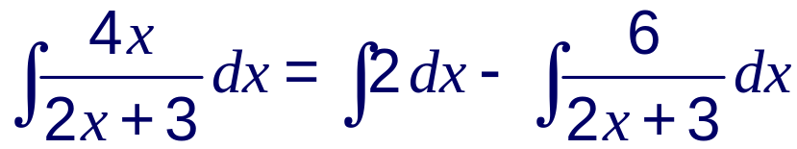


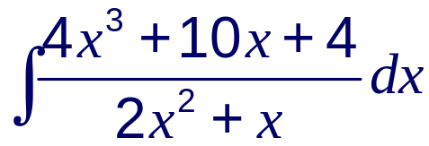
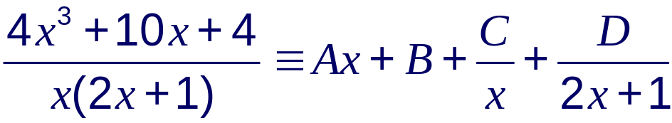
Using partial fractions in integration
We can now integrate:
More difficult examples may require us to set up an inequality or use polynomial long division. For example:
Find .
Let
Notes:
Explain that for the partial fraction in the last line, the numerator is of degree 3 and the denominator is of degree 2. The quotient must be of degree 1 (that is, of the form Ax + B).
The advantage of setting up an identity is that the partial fraction form is found from evaluating A, B, C and D.
Long division can also be used but the remainder will still have to be split into partial fractions.

Slide 22





Using partial fractions in integration
Multiplying through by x(2x + 1):
1
Substituting x = 0 into :
1
Substituting x = into :
1
A and B can now be found by comparing coefficients.

Slide 23



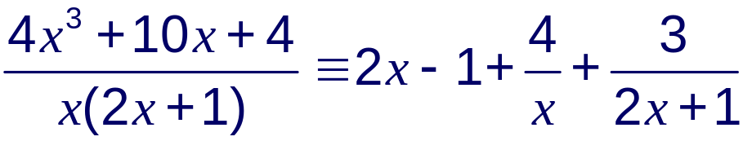
Using partial fractions in integration
Comparing coefficients of x³:
Comparing coefficients of x²:
So,

Slide 24




Using partial fractions in integration
We can now integrate:

Slide 25
First-order differential equations
Using trigonometric identities in integration
Using partial fractions in integration
First-order differential equations
Differential equations with separable variables
Using differential equations to model real-life situations
The trapezium rule
Examination-style questions
Contents
<number> of 66
© Boardworks Ltd 2006

Slide 26






Differential equations
A differential equation in two variables x and y is an equation that contains derivatives of y with respect to x. For example:
The order of a differential equation is given by the highest order of derivative that occurs in it.
First-order differential equations contain terms in ,
second-order differential equations contain terms in ,
third-order differential equations contain terms in , etc.
In this course we will only be looking at first-order differential equations.

Slide 27



Differential equations
The solution to a differential equation in x and y will take the form y = f(x).
The simplest differential equations are those of the form:
Differential equations of this form can be solved by integrating both sides with respect to x to give:
For example, suppose we have the differential equation:
Notes:
Stress that unlike algebraic equations, whose solutions are numbers, differential equations have solutions that are functions.
You may wish to add that if the solution cannot easily be written in the form y = f(x) then it can be given in an implicit form instead. The main point is that the solution should not contain any derivatives.

Slide 28






Differential equations of the form = f(x)
Integrating both sides with respect to x gives:
This is called the general solution
to the equation .
Since the constant c can take any value, this represents a whole family of solutions as shown here:

Slide 29


Finding a particular solution
Suppose that as well as being given the differential equation:
we are also told that when x = 1, y = 4.
We can use this additional information to find the value of the arbitrary constant c in the general solution:
Substituting x = 1 and y = 4:
4 = 2 + 1 + c
c = 1
This gives us the particular solution:

Slide 30





Solving first-order differential equations
Find the particular solution to the differential equation
given that y = 6 when x = 0.
Divide both sides by (x² + 1):
Integrate both sides with respect to x:
Writing the quotient
in the form .
We can use brackets because x² + 1 > 0.

Slide 31



Solving first-order differential equations
Substitute x = 0 and y = 6:
The particular solution is therefore:

Slide 32
Separable variables
Using trigonometric identities in integration
Using partial fractions in integration
First-order differential equations
Differential equations with separable variables
Using differential equations to model real-life situations
The trapezium rule
Examination-style questions
Contents
<number> of 66
© Boardworks Ltd 2006

Slide 33



Separable variables
Differential equations that can be arranged in the form
can be solved by the method of separating the variables.
This method works by collecting all the terms in y, including the ‘dy’, on one side of the equation, and all the terms in x, including the ‘dx’, on the other side, and then integrating.
Although the dy and the dx have been separated it is important to remember that is not a fraction.
For example, avoid writing:

Slide 34








Separable variables
Here is an example:
Find the general solution to .
Rearrange to give:
Separate the variables and integrate:
You can miss out the step
and use the fact that
to separate the dy from the dx directly.
We only need a ‘c’ on one side of the equation.
Notes:
This solution can be checked by differentiating the implicit function y² = x² + 4x + A.
The constant in the final solution has been labeled A to distinguish it from the c used in the previous step before multiplying by two.

Slide 35






Separable variables
Find the particular solution to the differential equation
given that y = ln when x = 0.
Using the laws of indices this can be written as:
Separating the variables and integrating with respect to x gives:
Take the natural logarithms of both sides:
Notes:
Stress that we are integrating both sides with respect to x, but that we are leaving out the working that ^{dy}/_{dx} dx = dy.

Slide 36



Separable variables
Given that y = ln when x = 0:
The particular solution is therefore:

Slide 37
Modelling real-life situations
Using trigonometric identities in integration
Using partial fractions in integration
First-order differential equations
Differential equations with separable variables
Using differential equations to model real-life situations
The trapezium rule
Examination-style questions
Contents
<number> of 66
© Boardworks Ltd 2006

Slide 38


Modelling real-life situations
Remember, the rate of change of one variable, say s, with respect to another variable, t, is .
Many real-life situations involve the rate of change of one variable with respect to another.
Since these situations involve derivatives they are modelled using differential equations.
For example, suppose we hypothesize that the rate at which a particular type of plant grows is proportional to the difference between its current height, h, and its final height, H.
The word “rate” in this context refers to the change in height with respect to time. We can therefore write:
Notes:
Explain that we can use brackets for ln(H – h) because H – h must always be positive.

Slide 39







Modelling real-life situations
We can write this relationship as an equation by introducing a positive constant k :
The general solution to this differential equation can be found by separating the variables and integrating.
Remember the minus sign, because we have –h. (H is a constant).
where A = e^{c}
Notes:
Establish that this equation tells us that the taller the plant is the more slowly it grows.

Slide 40



Modelling real-life situations
This is the general solution to the differential equation:
If we are given further information then we can determine the value of the constants in the general solution to give a particular solution.
For example, suppose we are told that the height of a plant is 5 cm after 7 days and that its final height is 20 cm.
We can immediately use this value for H to write:
Also, assuming that when t = 0, h = 0:

Slide 41






Modelling real-life situations
And finally using the fact that when t = 7, h = 5:
Take the natural logarithms of both sides:
This gives the particular solution:

Slide 42





Modelling real-life situations
Find the height of the plant after 21 days.
Using t = 21 in the particular solution gives
Using the fact that
Comment on the suitability of this model as the plant reaches its final height.
Using this model the plant will reach its final height when:
This will never happen.
Since e^{x} never equals 0 this model predicts that the plant will get closer and closer to its final height without ever reaching it.
Notes:
Explain that it is often the case that equations modelling real-life situations break down after a certain point. Sometimes this can be ignored if the equation holds within a certain range of values. If not, the model may have to be modified to reflect the given situation more accurately.
In this example, it can be shown that the plant will reach a height of 19.9 cm after about 92 days (2 months). Further growth after this time may be negligible.

Slide 43


Exponential growth
The most common situations that are modelled by differential equations are those involving exponential growth and decay.
Remember, exponential growth occurs when a quantity increases at a rate that is proportional to its size.
For example, suppose that the rate at which an investment grows is proportional to the size of the investment, P, after t years.
We can write this as:
This gives us the differential equation:
where k is a positive constant.

Slide 44





Exponential growth
If the initial investment is £1000 and after 5 years the balance is £1246.18, find the particular solution to this differential equation.
Integrating both sides with respect to t gives:
We don’t need to write |P| because P > 0.

Slide 45







Exponential growth
This is the general solution to .
Now, using the fact that when t = 0, P = 1000:
Also when t = 5, P = 1246.18:

Slide 46







Exponential growth
The particular solution is therefore:
Find the value of the investment after 10 years.
When t = 10:
How long will it take for the initial investment to double?
Substitute P = 2000 into the particular solution:

Slide 47


Exponential decay
Remember, exponential decay occurs when a quantity decreases at a rate that is proportional to its size.
For example, suppose the rate at which the concentration of a certain drug in the bloodstream decreases is proportional to the amount of the drug, m, in the bloodstream at time t.
Since the rate is decreasing we write:
This gives us the differential equation:
where k is a positive constant.

Slide 48





Exponential decay
Separating the variables and integrating gives:
This is the general solution to the differential equation .
Suppose a patient is injected with 5 ml of the drug.

Slide 49






Exponential decay
There is 4 ml of the drug remaining in the patient’s bloodstream after 1 hour. How long after the initial dose is administered will there be only 1 ml remaining?
The initial dose (when t = 0) is 5 ml and so we can write directly:
Also, given that m = 4 when t = 1 we have:
We could also write this as
This gives us the particular solution:

Slide 50





Exponential decay
When m = 1 we have:
So it will be about 7 hours and 12 minutes before the amount of drug in the bloodstream reduces to 1 ml.
Notes:
Comment on the fact that this model implies that the quantity of the drug in the bloodstream will never be 0 but will tend towards 0 as time increases.

Slide 51
The trapezium rule
Using trigonometric identities in integration
Using partial fractions in integration
First-order differential equations
Differential equations with separable variables
Using differential equations to model real-life situations
The trapezium rule
Examination-style questions
Contents
<number> of 66
© Boardworks Ltd 2006

Slide 52
The trapezium rule
Previously in the course we used the trapezium rule as a method for approximating the area under a curve.
Suppose, for example, that we wish to find the area under a curve, y = f(x), between x = a and x = b.
We can divide the area into four trapeziums of equal width, h.
y
y₀
y₁
y₂
y₃
y₄
The parallel sides of the four trapeziums are given by the five ordinates y₀, y₁, y₂, y₃ and y₄.
h
h
h
h
a
b
x
In general, if there are n trapeziums there will be n + 1 ordinates.

Slide 53


The trapezium rule
The approximate area using the trapezium rule is:
The ordinates have to be spaced out evenly so that the width of each trapezium is the same.
∴ For n trapeziums of equal width h :
In general, the trapezium rule with n trapeziums is:

Slide 54










The trapezium rule
Use the trapezium rule with four trapeziums to estimate the value of
to 3 significant figures.
By calculating the actual value of I, find the percentage error given using the trapezium rule with four trapeziums.
The width h of each trapezium =
Using a table to record the value of each ordinate to 3 s.f.:
x
0
1
2
1
y₀
y₁
y₂
y₃
y₄

Slide 55





The trapezium rule
We can now work out the area using
with h = and the ordinates given by the table.
= 0.531 (to 3 s.f.)
We can find the actual value of I using integration.

Slide 56



Calculating the percentage error
The percentage error is given by:
This gives us the percentage error:
This percentage is fairly large.
Remember that a greater degree of accuracy can be achieved by using more trapeziums.
Notes:
Note that the percentage error should always be positive and so strictly speaking we should consider the modulus (of the estimated value minus the actual value) divided by the actual value.
It may also be worth pointing out that the percentage error can only be found for integrals that can be evaluated exactly.

Slide 57
Examination-style questions
Using trigonometric identities in integration
Using partial fractions in integration
First-order differential equations
Differential equations with separable variables
Using differential equations to model real-life situations
The trapezium rule
Examination-style questions
Contents
<number> of 66
© Boardworks Ltd 2006

Slide 58



Examination-style question 1
Find the value of the constants A and B such that:
The region R is bound by the curve y = f(x), the coordinate axes and the line x = 2.
Find the area of the region R, writing your solution in the form ln a, where a is given to 3 significant figures.
a) Let

Slide 59





Examination-style question 1
Multiplying through by (4 – x)(3x + 1):
1
Substituting x = 4 into :
1
Substituting x = – into :
1

Slide 60





Examination-style question 1
b) The area of the region R is given by:

Slide 61

Examination-style question 2
Water is leaking from the bottom of a tank of height 1 m. The rate at which the water leaks from the tank is given by the differential equation.
where h is the depth of the water in the tank at time t and A is a positive constant.
Solve this differential equation given that the tank is initially filled to full capacity.
After three hours the depth of the water is 0.25 m. Find the depth of the water in the tank after four hours.
How long does it take for the tank to empty from full capacity?

Slide 62




Examination-style question 2
a)
Separating the variables and integrating gives:

Slide 63




Examination-style question 2
Given that when t = 0, h = 1:
The height of the water in the tank is therefore given by:

Slide 64






Examination-style question 2
b) When t = 3, h = 0.25 so:
∴ The particular solution is:

Slide 65



Examination-style question 2
After four hours, when t = 4:
∴ The height of the water after 4 hours is 0.11 m (to 2 d.p.).

Slide 66




Examination-style question 2
c) The tank will be empty when h = 0, that is when:
∴ The tank will take 6 hours to empty from full capacity.

